Slide 1
EE 16B Prelab Instructions:
Form a 2-student team (same team for the whole semester!)
Find a station (16B stations are 125-14 to -35 and -45 to -50)
Download the lab material (course website)
Introduce yourself to your neighbors!
Reminder: You will need your parts kits next week!

Slide 2
LAB 1: DEBUGGING

Slide 3
Lab Hierarchy
Professors
(Michel Maharbiz, Jaijeet Roychowdhury)
Administrative TAs
(Arda, Karina, Andrew, Peter)
Scheduling
Logistics
Lab TAs
Run lab sections
Lab-related administrative responsibilities
Lab Assistants
Answer lab-related questions
Check-off

Slide 4
Goal of Lab
Physically apply concepts learned in lecture
Build intuition as to how systems respond
Develop critical thinking and problem solving skills
Build interpersonal skills
HAVE FUN

Slide 5
Rules of Lab
NO FOOD OR DRINK AT LAB STATIONS
Seriously! No exceptions
Treat lab equipment with respect
Clean up after yourself
Return leads to appropriate locations
Turn off all equipment (only logout of computers)
Sweep up any wire clippings/trash/etc. from lab station
FAILURE TO CLEAN UP WILL RESULT IN LOST POINTS!
Be patient
GSI/AIs are trying to answer everyone’s questions as quickly as possible
There will be some wait time – try asking a neighbor!

Slide 6
Attending Other Sections
Lab is Mandatory!
You must attend the section that you are enrolled in through CalCentral
Acceptable reasons to miss lab: interview, family emergency, etc.
Not acceptable reasons to miss lab: sleeping, the midterm is this week, etc.
If you will miss lab, you must let your GSI know AHEAD of time
If you need to switch sections, and the section is full, you must find a student willing to switch with you
If you wish to attend another section, you must email your home GSI and the GSI of the other section and receive confirmation that your switch is okay

Slide 7
Grading
Lab is 30% of your total grade. That is broken down as:
Labs (6) 40%
Project 60%
Labs are done in pairs of 2
Each lab is graded on completion (all or nothing)
Labs must be checked off by a GSI within 1 week of assignment
Checkoffs must be complete by the start of the next lab!
Late labs will not be accepted for credit!
Project has its own breakdown (more information as the semester goes on)

Slide 8
Today’s Lab: Debugging
Three parts:
Read equipment overview/debugging slides
Complete the Debugging quiz (link in iPython Notebook):
Pass with 100% (show GSI)
Build an inverting amplifier
Swap with a partner and practice finding bugs
Order your free op-amp samples from TI

Slide 9
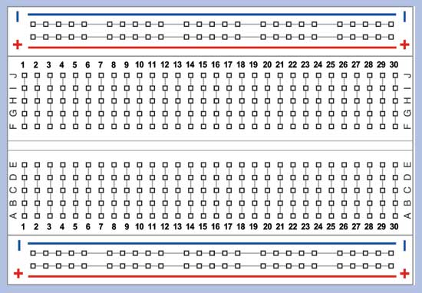
Breadboards
Quick Review:
‘Rows’ are connected
Rails are connected
Note: the two red rails are not connected together!
IC chips (ie: op amps) should straddle the notch in the middle of the board
Only remove ~1/4” of insulation
Do not shove a bunch of wire into the board – this will damage it!
Don’t plug oscilloscope probe directly into the board
Color code your wires to make debugging easier
Connected
Connected
Notch
Rails

Slide 10
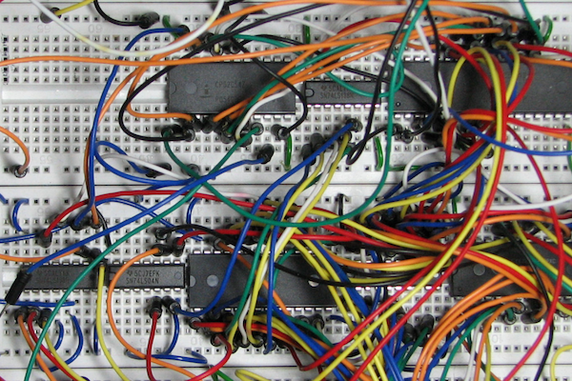
Debugging
Bugs happen (often) – need to learn skills to find/fix them
Best way is to test often!
Build small chunks of a circuit, then test
Make sure you know what to expect
The Oscilloscope and DMM are your friends!
Use them to collect clues as to what has gone wrong.
Build cleanly – GSIs will NOT help debug spaghetti!!

Slide 11
Checkoffs
Checkoff request link: lab.ee16b.org
Requirements for Checkoffs:
Show input and output signals simultaneously on the oscilloscope
Be ready to answer questions about your circuit
Show your completed debugging quiz
Show your order confirmation for op-amps
Needed components are usually in your kit
Get extra resistors only after looking through your kit
Kits do not include capacitors because they’re hard to read
Make sure you’re marked as checked off before leaving!

